Slide 1

DAYANANDA SAGAR UNIVERSITY
SCHOOL OF ENGINEERING
Department of Computer Science and Technology
Major Project Phase-I
BONE-FRACTURE DETECTION
Under the Supervision
Dr. Mouleeswaran S K
1
Presented By:
Harshitha R (ENG21CS0152)
Ishwarya Raman than (ENG21CS0163)
Likitha N (ENG21CS0204)
Nikitha V (ENG21CS0270)
Notes:
Title of the project
CSE Dept., SET-Jain University
1

Slide 2
Overview
Abstract
Problem Statement
Introduction
Social/Environmental Impact (If applicable)
State of the Art work
Design
Deliverables
References
*
Dept of CSE., SOE-Dayananda Sagar University
2 of 12

Slide 3
Abstract
Splitting our data into training, validation, and test sets to ensure the model generalizes well.
This model can be integrated with other health technologies, such as electronic health records (EHRs) and telemedicine platforms, to enhance overall patient care and management.(Why this work)
Generate a dataset and insights that can be used for further research into fracture types, patterns, and treatment outcomes, contributing to the broader medical knowledge base. (What you plan to do)
Approaching this data in order to perform preprocessing tasks such as resizing, normalization, and augmentation to improve model performance and generalization. (How will you do-Approach)
Overall, the project aims to deliver a practical, efficient, and effective deep learning-based solution for bone fracture detection that benefits both patients and healthcare providers. (What we can expect as result)
*
Dept of CSE., SOE-Dayananda Sagar University
3 of 12

Slide 4
Problem Statement
Problem Statement: Create a Python-based toolkit to evaluate the performance of bone fracture detection models and facilitate optimization.
Solution: Build a Python module that can interface with common DICOM imaging systems using libraries such as pydicom. Ensure compatibility with various image formats and provide an API or a user interface for seamless integration into clinical workflows.
(guys make sure to check this solution prply I have added this something like that only related to this)
*
Dept of CSE., SOE-Dayananda Sagar University
4 of 12

Slide 5
Introduction
Out of numerous health issues, the treatment and detection of bone fractures, that affects a large number of people belonging to every age group, is becoming necessary in the a in fashion society.
In the scope of our research and project, we have been studying this issue
of classification and have been trying, based on previous attempts and
researches, to develop and fine tune a feasible solution for the medical field
in terms of identification and classification of various bone fractures in the scope of modern models., using Python language.
It is also a typical disadvantage in many countries that are already developed where the fracture varieties are also increasing the cut. Fractures could take place because of an easy miss happening or also because of any disease.
Out of numerous health issues, the treatment and detection of bone fractures, that affects a large number of people belonging to every age group, is becoming necessary in the a in fashion society.
*
Dept of CSE., SOE-Dayananda Sagar University
5 of 12

Slide 6
Social/Environmental/ Technical Impact
State in one or two sentences
Can use pics/images to explain
*
Dept of CSE., SOE-Dayananda Sagar University
6 of 12

Slide 7
State of the Art-work
Author’s Name/ Paper Title | Conference/Journal Name and year | Technology/ Design | Results shared by author | What you infer
BONE FRACTURE DETECTION USING PYTHON J.Raja Santhiya 1 , Mrs.P.Jasmine Lois Ebenezer 2 | International Journal of Creative Research Thoughts (IJCRT) | Technology: Canny Edge Detection Design: Convolutional Neural Networks (CNNs) | Provides 85% accuracy rate, further refinement and expansion are needed to improve its effectiveness, particularly with CT images and in fracture classification. | Improve the system's overall effectiveness and applicability in clinical settings.
*
Dept of CSE., SOE-Dayananda Sagar University
7 of 12

Slide 8
Author’s Name/ Paper Title | Conference/Journal Name and year | Technology/ Design | Results shared by author | What you infer

Slide 9
Design
A high-level design will include data flows, flowcharts, data structures:
System architecture
Database design
Brief mention of all the platforms, systems, services, and processes the product would depend on
Brief description of relationships between the modules and system features
*
Dept of CSE., SOE-Dayananda Sagar University
9 of 12

Slide 10
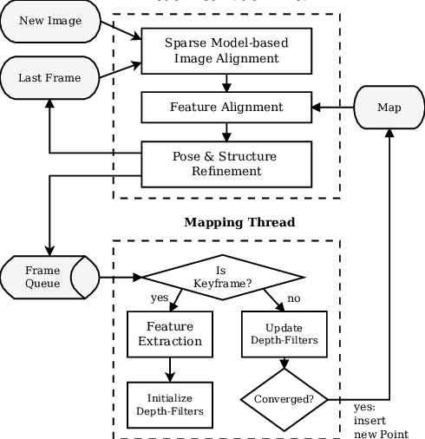
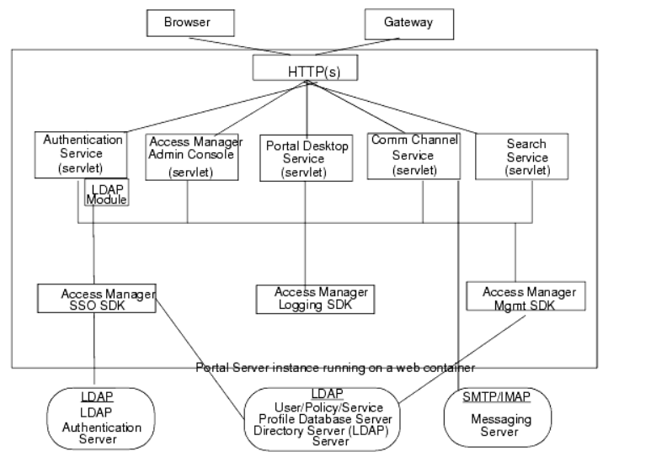
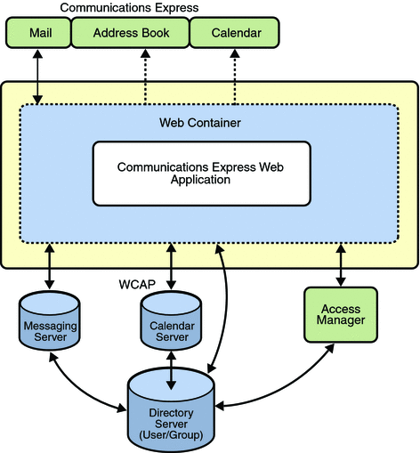
Design- few examples
*
Dept of CSE., SOE-Dayananda Sagar University
10 of 12

Slide 11
Design- Screen design
*
Dept of CSE., SOE-Dayananda Sagar University
11 of 12

Slide 12
Deliverables
At the end of project in 8th semester what output is expected
*
12 of 12
Dept of CSE., SOE-Dayananda Sagar University

Slide 13
References
List of all the papers that were referred as mentioned in the Literature survey section to be given in the IEEE format
*
Dept of CSE., SOE-Dayananda Sagar University
13 of 12

